Slide 1
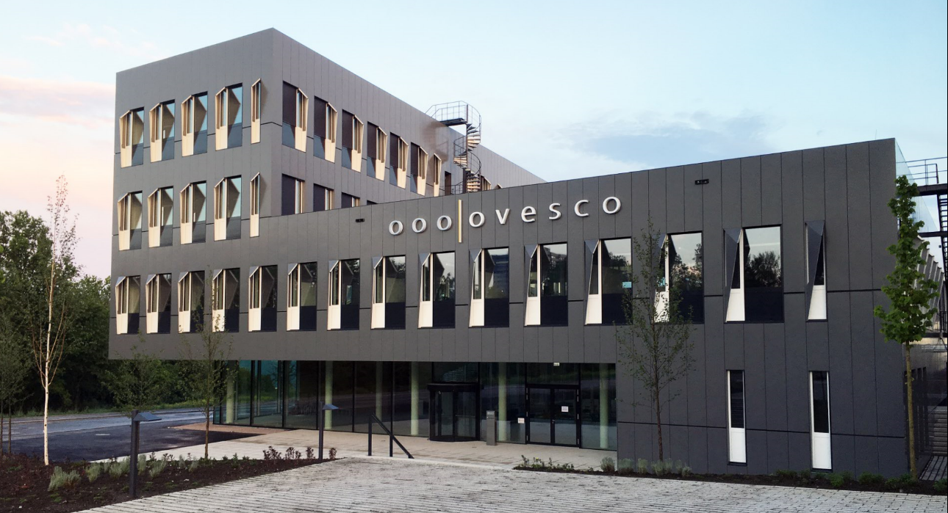

Medical Devices Regulation (MDR) and its effects on industry and patient care
5th annual Czech Quality Conference
„Quality: a long-term strategy for success”
Valec, 25.11.2025
Marc Schurr
Ovesco Endoscopy
novineon CRO, Tuebingen, Germany

Slide 2
1
Cornerstones of the European MDR
2
Political motivation for MDR
3
Consequences for industry
4
Consequences for clinical medicine
5
Summary and outlook

Slide 3
1
Cornerstones of the European MDR
2
Political motivation for MDR
3
Consequences for industry
4
Consequences for clinical medicine
5
Summary and outlook

Slide 4
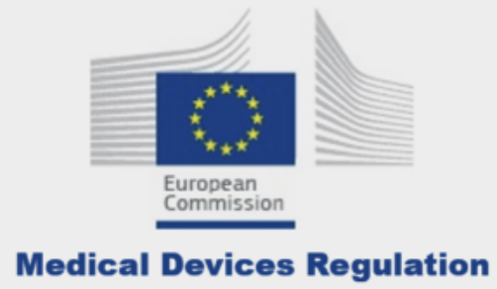
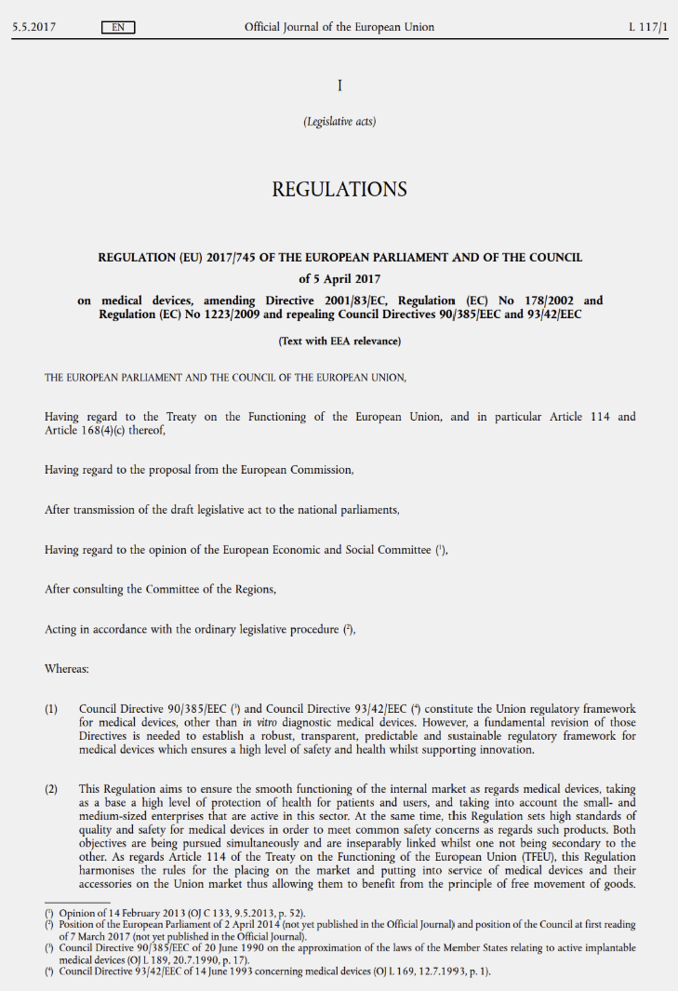
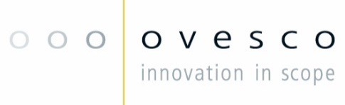
Cornerstones of the European MDR.
In 2017 the European Medical Device Regulation (MDR, 2017/745) introduced several significant changes compared to the previous Medical Device Directive (MDD, 93/42).
Expanded Scope: The MDR now includes products without a medical purpose but with similar risks to medical devices, such as colored contact lenses and cosmetic implants.
Stricter Clinical Evaluation Requirements: There are increased requirements for clinical data and evaluations to ensure the safety and performance of medical devices. Manufacturers must conduct and document more comprehensive clinical studies.
Enhanced Traceability Requirements: Introduction of a unique device identification (UDI) system to improve product traceability and enhance safety.
Stronger Market Surveillance: The MDR implements a robust system for market surveillance, ensuring continuous review of products after they are placed on the market.
Enhanced Transparency and Access to Information: Introduction of the European Database for Medical Devices (EUDAMED), providing comprehensive information about products, manufacturers, and certifications to increase transparency.
These changes aimed to improve the safety and quality of medical devices in the EU and strengthen consumer confidence.

Slide 5

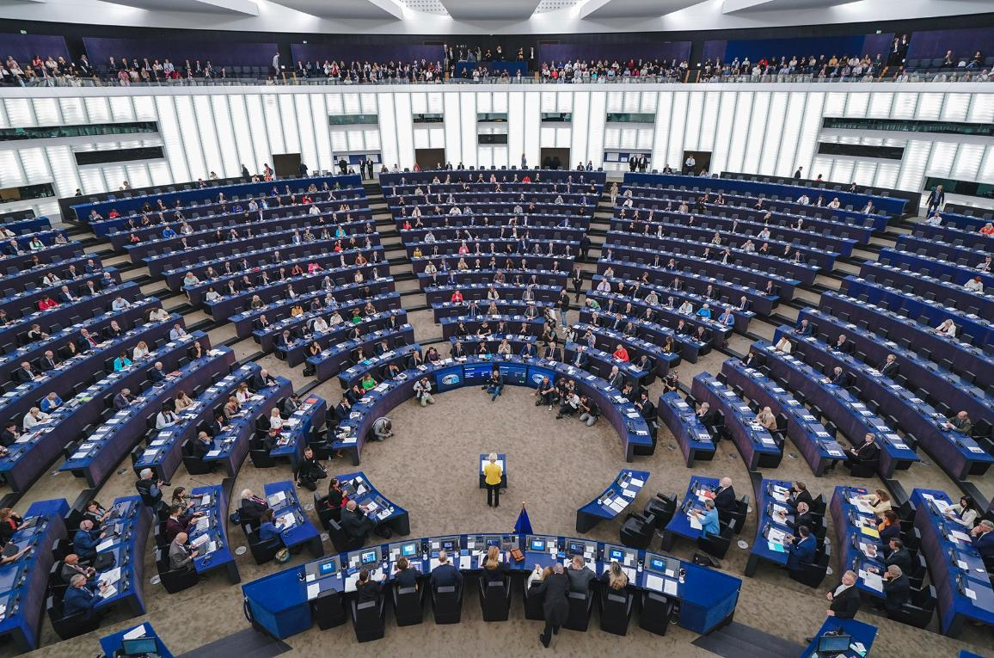
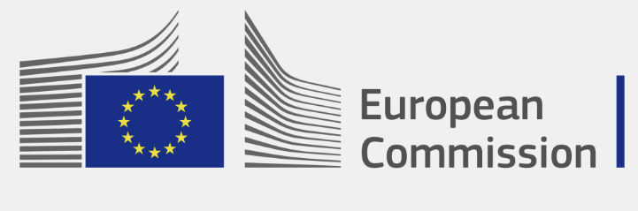
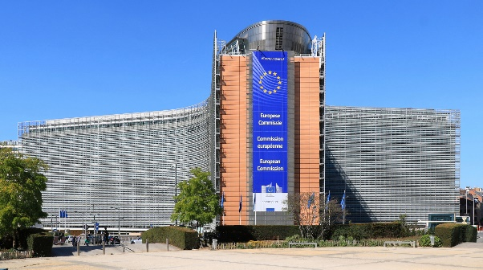
Cornerstones of the European MDR.
The European Parliament and the European Commission were driven by several assumptions and reasons to implement the Medical Device Regulation.
Need for Improved Safety: There was a formulated need to enhance the safety of medical devices following incidents and recalls that highlighted vulnerabilities in the existing regulatory framework.
Technological Advancements: Rapid advancements in medical technology necessitated updated regulations to accommodate new types of devices and ensure their safe integration into healthcare systems.
Inconsistencies in Member States: Variations in how the previous Medical Device Directive (MDD) was implemented across EU member states led to inconsistencies in safety standards and market access, prompting the need for harmonization.
Increased Public Demand for Transparency: There was growing demand for greater transparency and access to information regarding medical devices, driven by increased consumer awareness and advocacy.
Enhancing Post-Market Surveillance: The need for more effective post-market surveillance was identified to ensure ongoing compliance and address safety issues promptly after devices are introduced to the market.
These assumptions aimed to create a more reliable, transparent, and efficient regulatory system.

Slide 6
1
Cornerstones of the European MDR
2
Political motivation for MDR
3
Consequences for industry
4
Consequences for clinical medicine
5
Summary and outlook

Slide 7
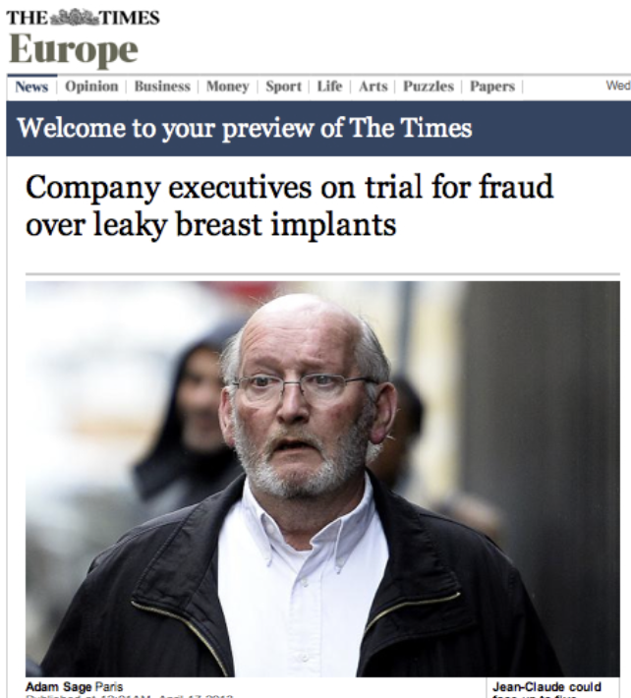
Political motivation for MDR.
Several high-profile incidents were cited as reasons for the need to sharpen the regulatory framework for medical devices in Europe, leading to MDR.
These incidents included:
PIP Breast Implant Scandal (criminal action): The Poly Implant Prothèse (PIP) breast implant scandal involved the use of industrial-grade silicone instead of medical-grade silicone, leading to widespread health concerns and implant failures.
Metal-on-Metal Hip Implants: Issues with metal-on-metal hip implants, which were found to release metal particles into the body, causing tissue damage and other health problems, underscored the need for better post-market surveillance and clinical evaluation.
Transvaginal Mesh Complications: Complications associated with transvaginal mesh implants, including pain and organ damage, raised concerns about the adequacy of clinical testing and monitoring of medical devices.
The only EU-specific case with a European manufacturer
These incidents were cited to emphasize the need for more stringent regulations and enhanced post-market surveillance thorough MDR. Political pressure from the side of consumerist lobby associations.
Manufacturers were almost all US firms, not Euroean

Slide 8

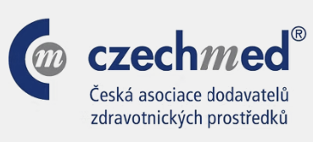
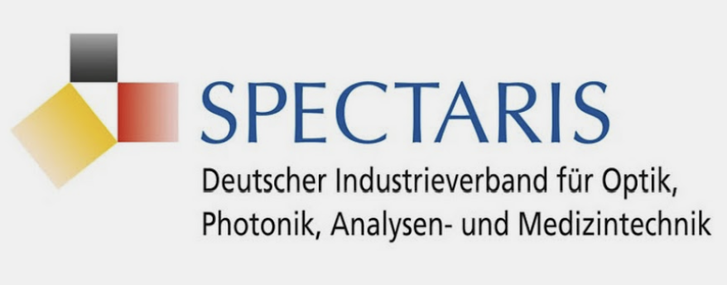
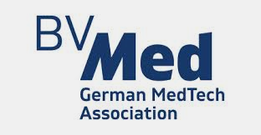
Political motivation for MDR.
During the discussions surrounding the implementation of MDR, the medical technology industry and its associations had several concerns.
Impact on Innovation: The industry was concerned that the stricter regulations could stifle innovation by increasing the time and cost required for new products.
Implementation Challenges: There were worries about the practical challenges of implementing the new requirements, particularly for small and medium-sized enterprises.
Transition Period: Industry representatives advocated for a longer transition period to allow companies sufficient time to adapt to the new regulatory framework without disrupting their operations.
Cost Implications: The increased regulatory burden was expected to lead to higher compliance costs, which could impact the competitiveness of European medical device manufacturers.
Need for Clarity: The industry sought clearer guidelines and support from regulatory bodies to ensure a smooth transition and avoid uncertainties in the interpretation of the new rules.
Collaboration with Notified Bodies: There was a call for better collaboration and communication with Notified Bodies to ensure efficient and consistent certification processes under the new regulation.
Overall, there was significant concern about the potential negative impacts on innovation, costs, and market dynamics

Slide 9
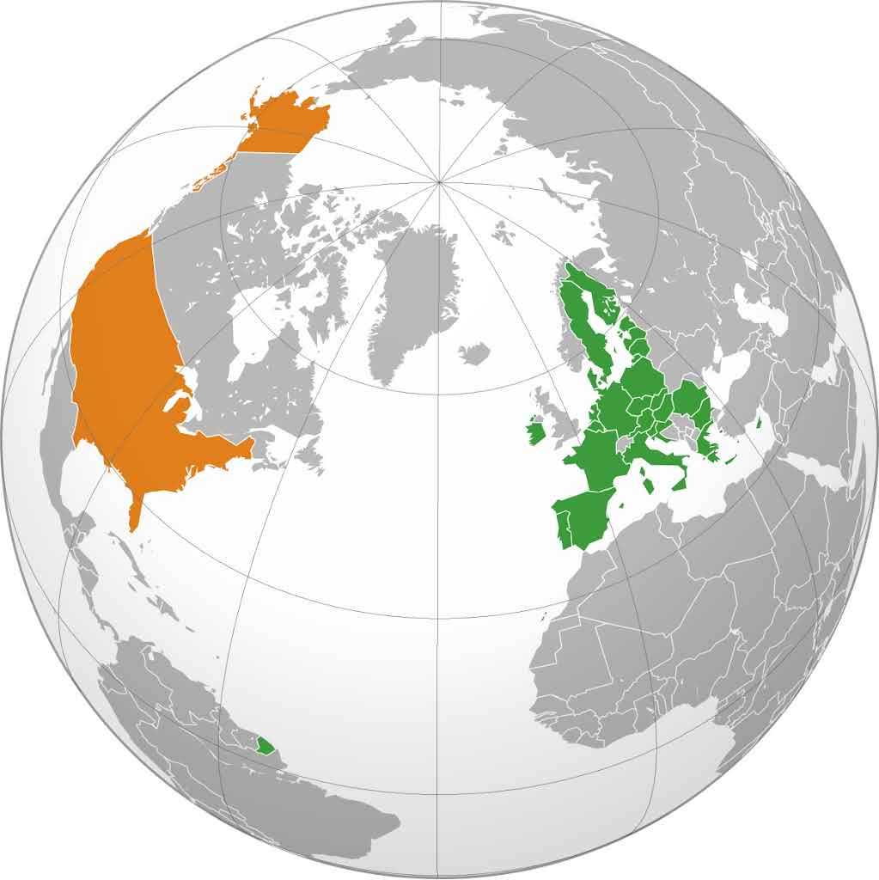
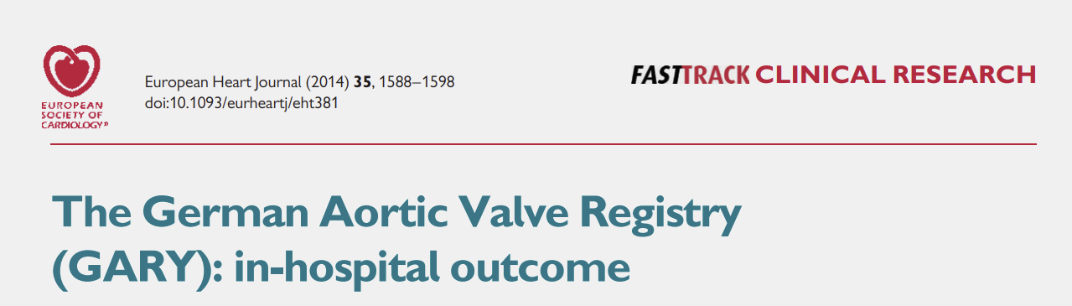
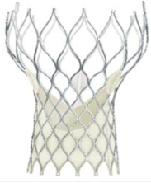


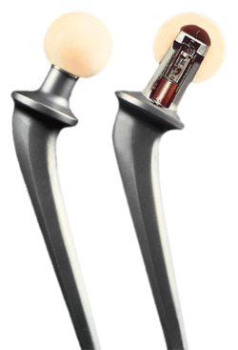
Political motivation for MDR.
Were there indications in the clinical literature of inferiority of European medical devices in international comparison?
Fundamental political notion that led to MDR: EU medical devices are under-regulated when compared to their US peers. European patients are put at risk.
Was the political assumption backed by facts ?: EU medical devices are under-regulated when compared to their US peers. European patients are put at risk.
Exemplary high-risk medical devices,e.g.
In case of systematically weaker performance of assumably under-regulated European devices, clinical data in Europe would likely be worse than corresponding US data.
Are there indications in the pre-MDR literature for that ?
Source: Wikipedia

Slide 10
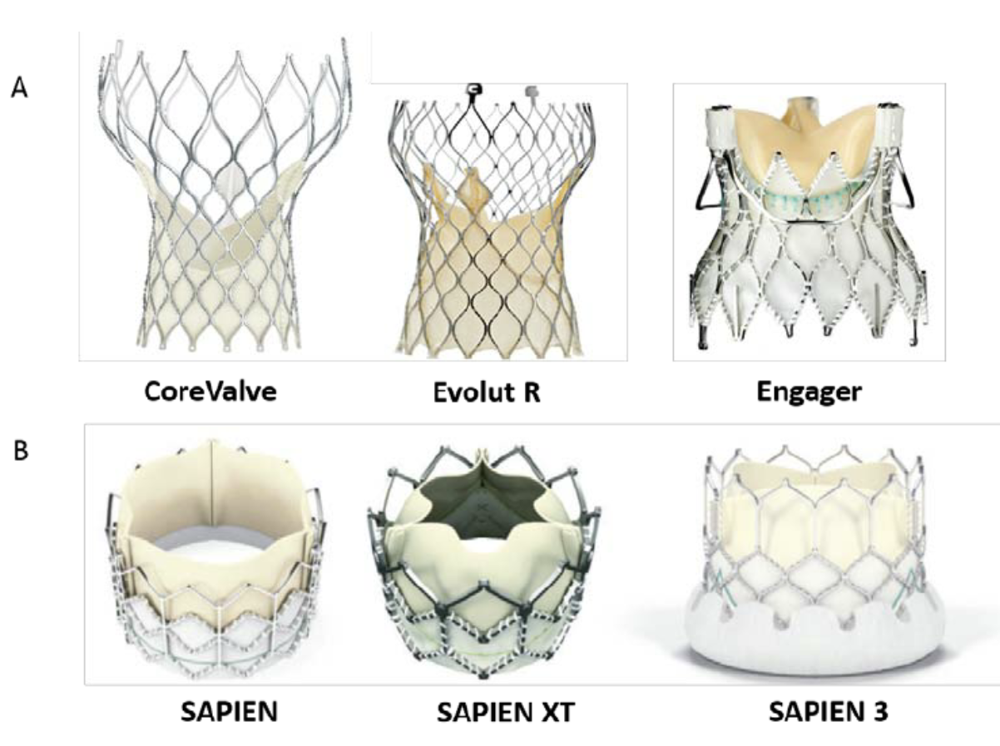
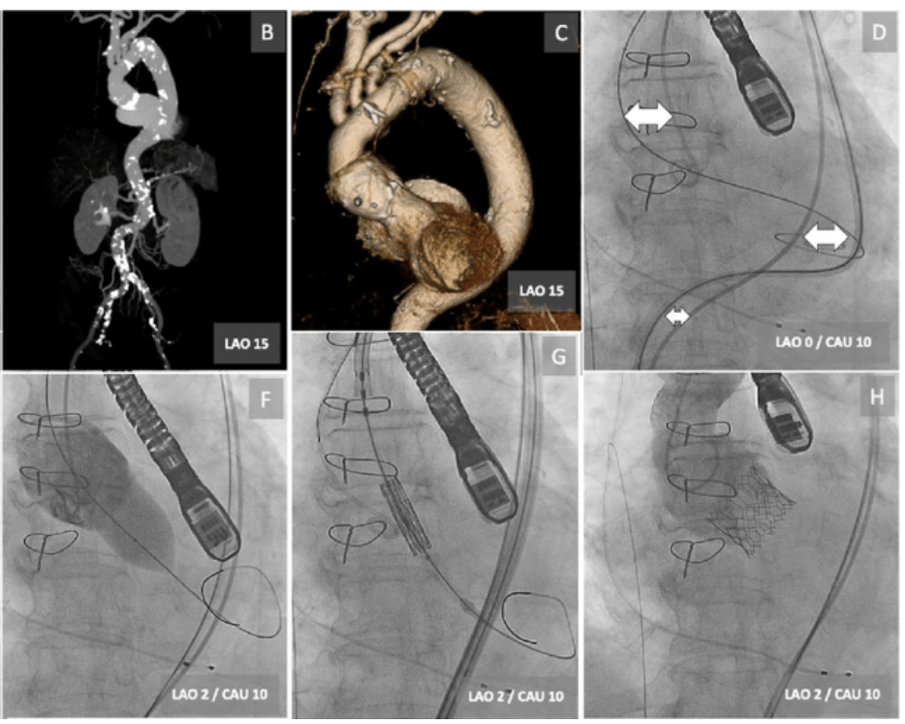
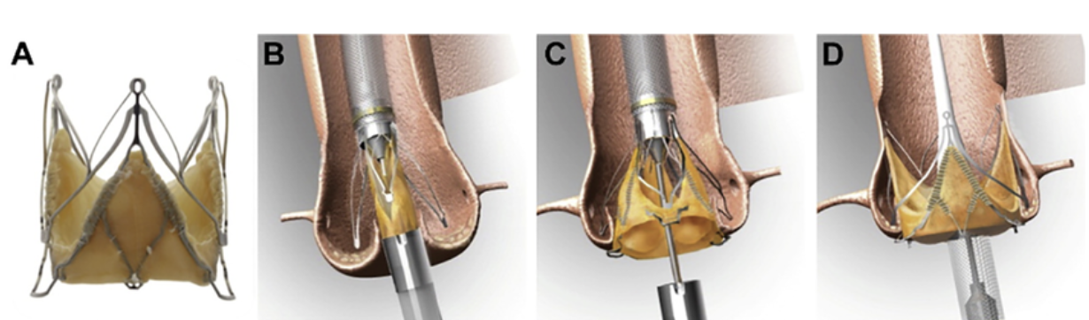
Political motivation for MDR.
Example I: TAVI aortic valve implantation.
Different types of TAVI aortic valves:
Implantation procedure:
From:
Ortega-Paz, Luis & Giacchi, Giuseppe & Brugaletta, Salvatore & Sabaté, Manel. (2015). Percutaneous Transcatheter Aortic Valve Implantation: A Review Focus on Outcomes and Safety. AIMS Medical Science. 2. 200-221. 10.3934/medsci.2015.3.200.
Jenavalve
From:
Kachinohe, Daisuke & Shitan, Hidemasa & Kaneko, Umihiko & Kobayashi, Ken & Mitsube, Keijiro & Koushima, Ryuji. (2020). Transfemoral transcatheter aortic valve implantation for bicuspid aortic stenosis with tortuous aorta after total arch replacement. Cardiovascular Intervention and Therapeutics. 37. 10.1007/s12928-020-00738-3.
From:
Khan, Adnan & Aslam, Aqsa & Satti, Khawar & Ashiq, Sana. (2020). Infective endocarditis post-transcatheter aortic valve implantation (TAVI), microbiological profile and clinical outcomes: A systematic review. PLOS ONE. 15. e0225077. 10.1371/journal.pone.0225077.

Slide 11
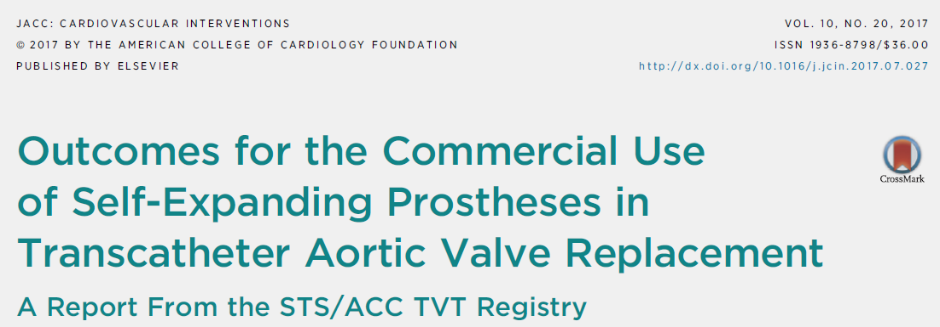
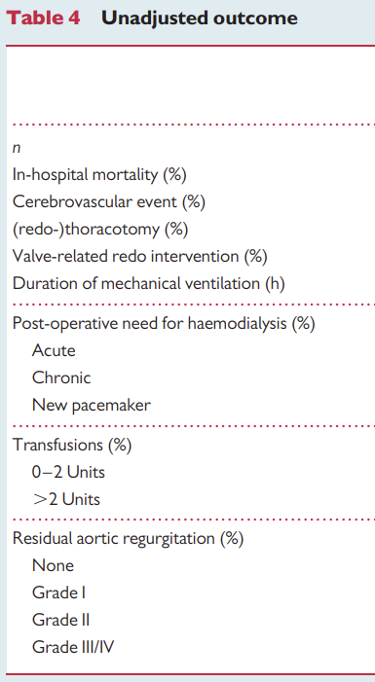
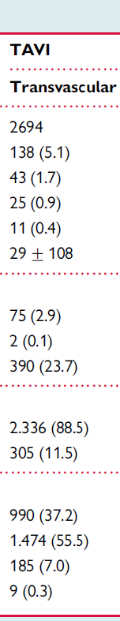
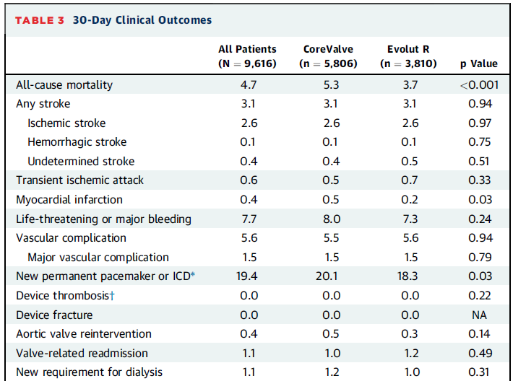
Political motivation for MDR.
Pre-MDR comparison of clinical TAVI registry data: key outcome parameters are identical.
Pre-MDR publications from Germany (2014) and the US (2017) show no differences in essential clinical outcomes for TAVI.

Slide 12
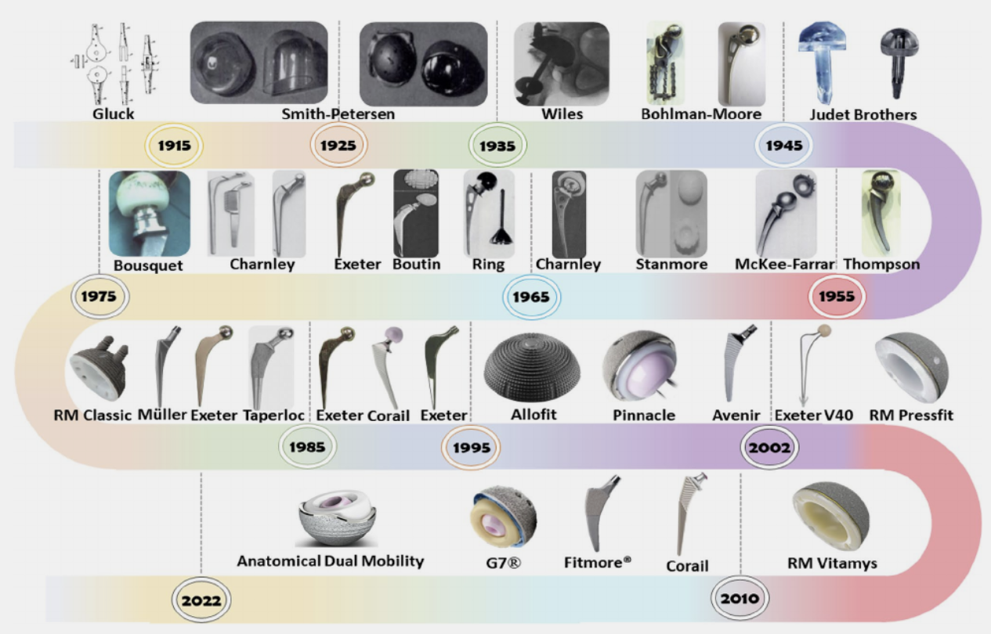
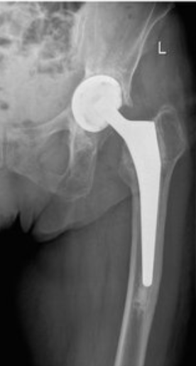
Political motivation for MDR.
Example II: Endoprosthetic hip replacement.
Evolution: different types of hip implants:
Implanted device:
Okhovat, Amir & Shahbazi, Parmida & Taghva Nakhjiri, Mobina & Boroujerdi, Mohammad & Soleimani, Mohammad & Azimzadeh, Tina & Shafiei, Hossein & Golbakhsh, Mohammadreza. (2025). The impact of COVID-19 in total hip arthroplasty: a comparison study in a center without elective surgery protocols. BMC Musculoskeletal Disorders. 26. 10.1186/s12891-025-09240-4.
From:
iDas, Juliana & Silva, Filipe & Gasik, Michael & Miranda, Maria & Bartolomeu, Flávio. (2023). Unveiling additively manufactured cellular structures in hip implants: a comprehensive review. The International Journal of Advanced Manufacturing Technology. 130. 1-50. 10.1007/s00170-023-12769-0.

Slide 13


Political motivation for MDR.
Pre-MDR comparison of national hip registries data: implant survival rates are the same.
Initial EPRD data (2012–2015): Five-year survival rates for hip endoprostheses were around 95–97%. Source: Perka C, Labs K, et al. Orthopaede. 2015;44(12):923-928.
Long-term data from earlier German studies: Studies from arthroplasty centers reported 10-year survival rates of 90–95% for both cemented and uncemented prostheses.
AJRR 2016 Annual Report: The five-year survival rate for hip prostheses was about 95%. Source: AJRR 2016 Annual Report.
Earlier long-term data from the US Medicare system: Studies showed 10-year survival rates of 90–93% for primary hip endoprostheses. E.g. Katz JN, et al. "Total Hip Replacement." N Engl J Med. 2005;353:2473-2481.
Pre-MDR publications from Germany (2015) and the US (2016) show no differences in implant survival rates.

Slide 14
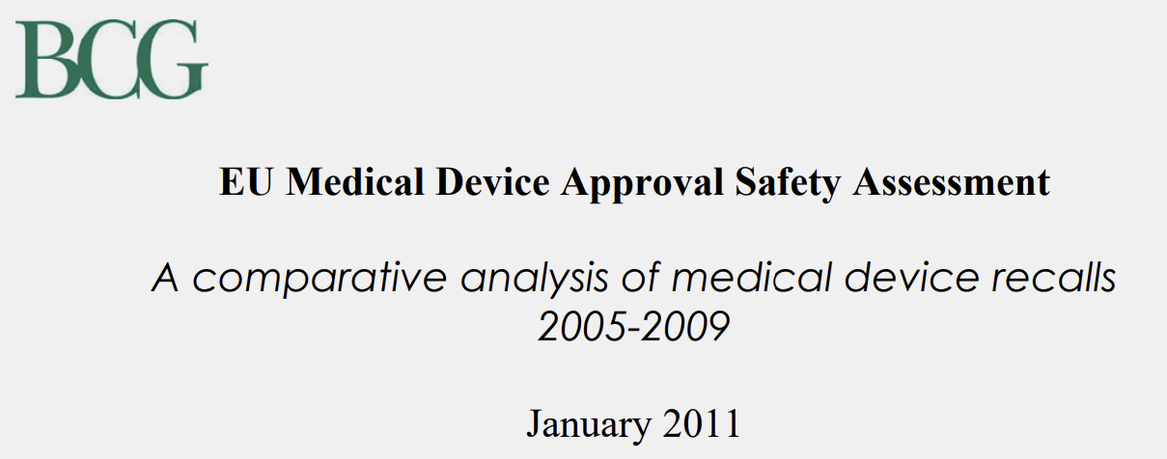
Political motivation for MDR.
A comparative assessment of regulatory approval by the Boston Consulting Group did not reveal differences in device safety between Europe and the US.
Comparable Safety Levels: The analysis finds no substantial evidence that medical devices are less safe in the EU than in the USA. Recall rates and reported safety issues are similar in both regions.
Different Approval Pathways, Similar Safety: Despite the EU’s less burdensome and faster approval process (CE marking) compared to the stricter and slower FDA process in the USA, there is no indication of increased patient risk in Europe.
Post-Market Surveillance is Key: In both systems, post-market surveillance is crucial for identifying and managing risks. The study highlights that both regions are continuously working to improve their post-market monitoring.
Transparency and Data Availability: The availability and transparency of safety data are generally higher in the USA due to the FDA, while the EU is seen as needing improvements in traceability and public information
Data Sources:
The study is based on a review of publicly available data, including recall databases, scientific literature, and regulatory reports from both the EU and the USA.
Scope of Analysis:
The analysis focuses on high-risk medical devices, particularly implantable devices, as these are most relevant for patient safety concerns.
Comparative Approach:
The methodology involves comparing approval processes, recall rates, and post-market surveillance systems between the EU (CE marking) and the USA (FDA approval).
From:
https://www.medtecheurope.org/wp-content/uploads/2015/07/01012011_BCG_EU-medical-device-approval-safety-assessment_Backgrounder.pdf

Slide 15
1
Cornerstones of the European MDR
2
Political motivation for MDR
3
Consequences for industry
4
Consequences for clinical medicine
5
Summary and outlook

Slide 16
Consequences for industry.
Medtech has always been a strongly regulated industry – MDR doubled the share of regulatory expense in the overall cost structure of companies.
Share of Regulatory Costs in heavily regulated industries:
Medical Technology: Estimates suggest regulatory-related costs (e.g., approval, quality management, documentation, audits) account for about 8–12% of a company’s total costs. For small companies, the share can be even higher. Before MDR (under MDD) the range was 4–8% of total company costs
Pharmaceutical Industry: The share of regulatory costs can be 15–25% or more, especially for the development and approval of new drugs.
Food Industry: Regulatory costs are usually in the range of 5–10% of total costs, depending on the product and market.
Financial Industry: Compliance and regulatory costs can account for 10–20% of operating costs, especially for large banks and insurance companies.
Medical technology is regulated at a level similar to the pharmaceutical and financial industry, but gross margines are lower (55-75% vs 70-90% or 60-80 %) → margin pressures result.
The cost share for regulatory expenses in medtech has doubled due to MDR.

Slide 17
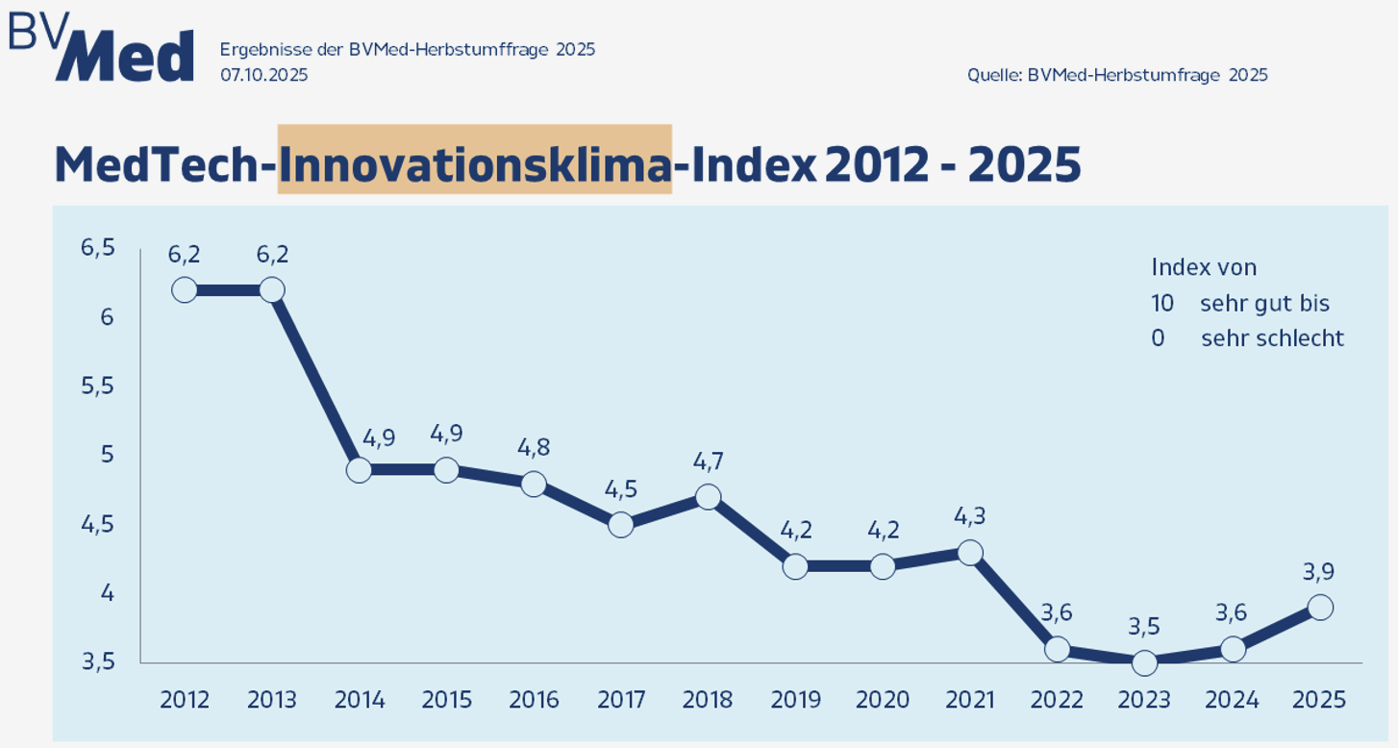
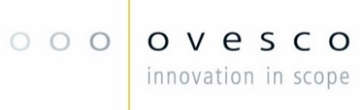
Consequences for industry.
17
The innovation climate of the German medtech industry showed a marked decline triggered by MDR-effects kicking in by 2020/21 and early signs of recovery.
MDR effects on product innovation kicking in.

Slide 18
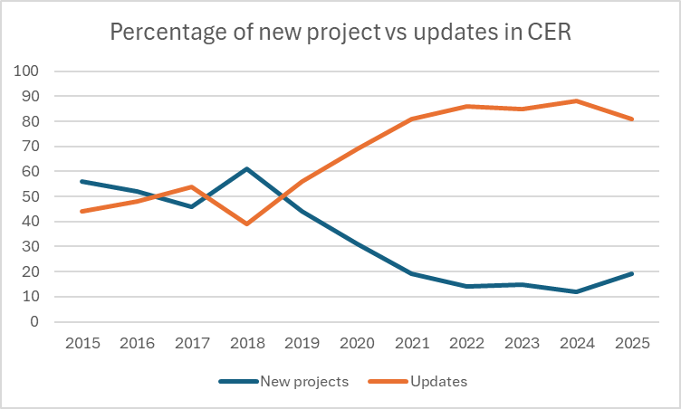

Consequences for industry.
On the “micro-scale”: evolution of new projects (launches) vs updating of existing files in the practice of a medtech CRO (novineon CRO).
Maintenance of existing portfolio
Decline of innovation activity
The „valley of death“:
- R&D staff diverted to regulatory affairs
- Increase in lag-time of files submitted to NB‘s
The „dawn of recovery“ ?

Slide 19
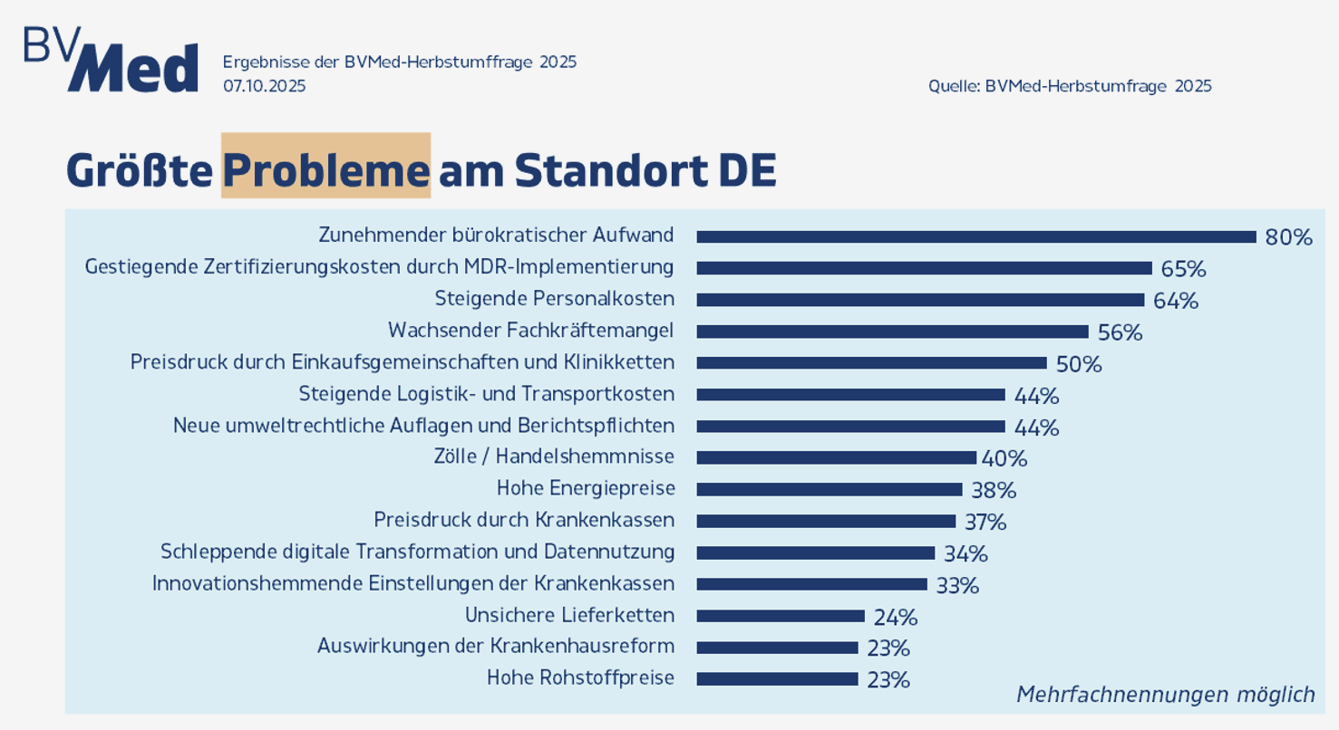
Consequences for industry.
19
Biggest challenges seen by German MedTech companies refer to compliance cost increases.
Growing bureaucracy, regulatory expense and are seen as the most negative effects.
The increasing pressure on the profitability is also affecting investments at locations in Germany. 22 % of the companies surveyed are reducing their investments compared to the previous year, while 19 % are increasing their investments. For 41 % of the participating companies, investments remain unchanged.
31 % are relocating investments abroad (mostly EU and US).

Slide 20
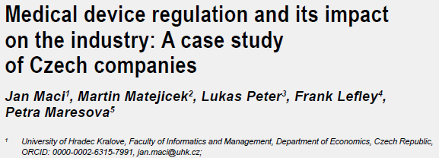
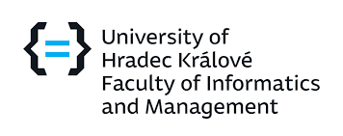
Consequences for industry.
Concrete consequences for the European medtech industry and its competitiveness.
Negative consequences of the MDR for the industry cited in reviewed literature (non-systematic)
Increased costs: 85% of companies perceive increased costs due to MDR [2].
Reduced profitability: Approximately 60% of companies see negative impact on profitability [2] [5].
Portfolio reduction: About one-third of companies state they will almost certainly discontinue at least one product from their current portfolio [5] [3].
Inability to pass on costs: Companies are unable to transfer the increased regulatory costs to their customers, directly affecting their profit margins [5].
Innovation delay: Nearly two-thirds of companies report postponing innovation activities due to MDR [5].
Almost 50% of companies are dissatisfied with the MDR, with only about 35% perceiving it neutrally [5].
Maci, J., Matejicek, M., Peter, L., Lefley, F., & Maresova, P. (2024).
Medical device regulation and its impact on the industry: A case study of Czech companies.
E&M Economics and Management, 27(2), 32–49.
Maci, J., Matejicek, M., Peter, L., Lefley, F., & Maresova, P. (2024). Medical device regulation and its impact on the industry: A case study of Czech companies. E&M Economics and Management, 27(2), 32-49. Oltmanns, E., D'Agosto, M., & Spitzenberger, F. (2025). Challenges and inconsistencies in interpreting clinical data requirements under Regulation (EU) 2017/745 for medium-risk, Class IIb non-implantable medical devices. Therapeutic Innovation & Regulatory Science.
Daryanani, A. E., Maduekwe, U. N., Baird, P., & Ehrenfeld, J. M. (2025). The safety of medical devices: The roles of standards organizations and regulatory bodies. Journal of Medical Systems.
Thottunkal, S. (2025). Regulatory Stringency and Impacts on Equity and Innovation in Medical Devices: Insights from the EU MDR 2017 and Considerations for the FDA regarding AI. Journal of Regulatory Science.
Trabuco, E. C., & Montori, V. M. (2018). Mesh in pelvic surgery: Regulatory shortcomings and clinical consequences. Commentary in the field of urogynecology.

Slide 21
1
Cornerstones of the European MDR
2
Political motivation for MDR
3
Consequences for industry
4
Consequences for clinical medicine
5
Summary and outlook

Slide 22


Consequences for clinical medicine.
Recently multiple scientific medical societies have commented about needed devices being discontinued and device innovation being slowed down.
Negative impacts of the MDR on medical care:
Massive reduction in available medical devices: According to one estimate, due to the MDR, approximately 50% of all medical devices will be removed from the market and 30% of manufacturers will not survive, potentially risking patient access to needed devices [3].
Discontinuation of essential legacy devices: The increased costs and prolonged approval timelines have resulted in market contractions and the discontinuation of essential legacy devices, which can limit access to life-saving or well-established treatments [4].
Barriers to patient access, especially for underserved populations: Cost-driven product rationalization could especially hurt underserved populations, as manufacturers may discontinue less profitable products that are nonetheless medically necessary [3].
These points show that the MDR not only affects the industry but also has direct, quantifiable negative consequences for medical
care and patient access to devices.
Tuebingen University Hospital (symbolical)

Slide 23
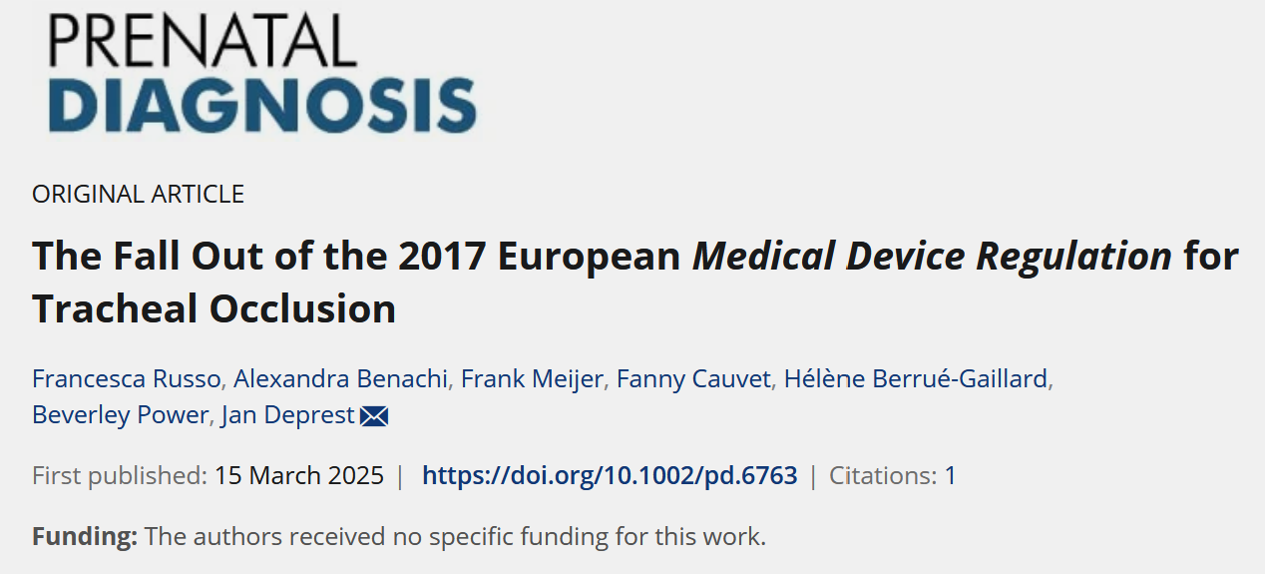

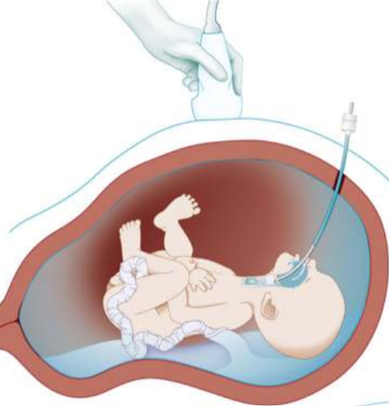
Consequences for clinical medicine.
Device availability has become a criticized issue, especially in rare diseases.
Congenital diaphragmatic hernia (CDH) is a congenital anomaly with high mortality and morbidity
mainly due to pulmonary hypoplasia and hypertension. Temporary fetal tracheal occlusion to promote prenatal
lung growth may improve survival.
Surveyed 50 fetal surgery centers worldwide
All balloons in Europe are expired. Supply issues exist in Australasia and South-America
Some centers manage shortages by importing from other countries
Conclusion by the authors:
This highlights the unintended consequences of stringent medical device regulations, leading to their unavailability for beneficial procedures or complicated administrative processes, even as these devices remain available outside the EU.

Slide 24


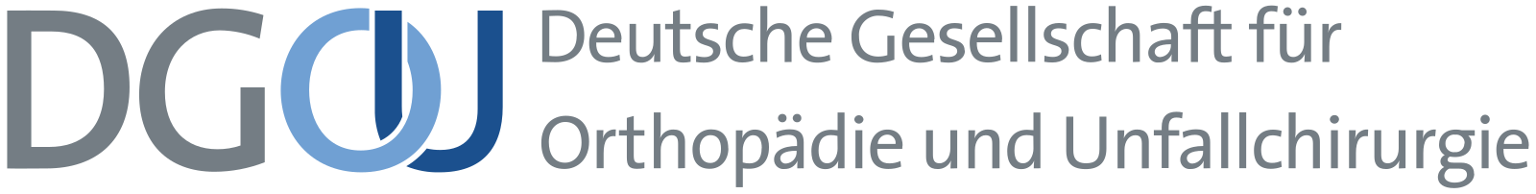

Consequences for clinical medicine.
Medical societies from a range of clinical specialties have publicly voiced concrete concerns about the impact of the MDR.
1. German Society for Orthopaedics and Trauma Surgery (DGOU):
DGOU has repeatedly pointed out that special implants and niche products are disappearing from the market because the costs and effort for MDR certification are too high for manufacturers.
Quote: “The care of patients with rare diseases or complex injuries is at risk because important special implants are no longer available.”
2. German Society of Cardiology (DGK):
The DGK has warned of shortages of certain pacemakers, catheters, and other cardiological specialty products.
Quote: “The MDR is leading to proven products being withdrawn from the market because recertification is no longer economically viable.”
3. German Society for Pediatric Surgery (DGKCH):
The DGKCH has specifically highlighted the problem with pediatric implants and instruments, which are often only needed in small quantities.
Quote: “For many special pediatric implants, there are no alternatives. If these products are discontinued, the care of young patients is at risk.”
4. European Society of Cardiology (ESC):
The ESC has expressed similar concerns at the European level and, in statements, pointed to the risk of supply shortages and barriers to innovation.

Slide 25
1
Cornerstones of the European MDR
2
Political motivation for MDR
3
Consequences for industry
4
Consequences for clinical medicine
5
Summary and outlook

Slide 26
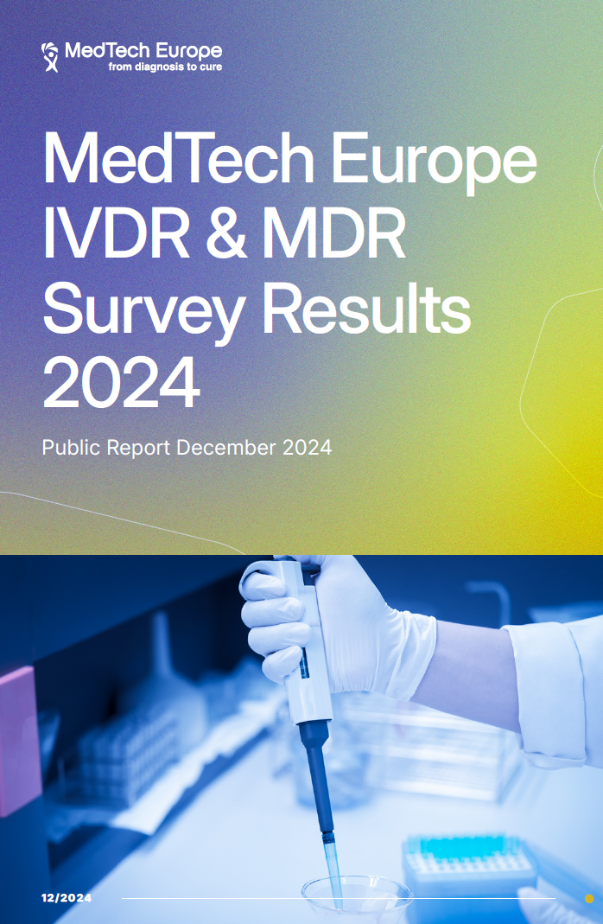
Summary and outlook.
A survey of the medtach association MedTech Europe comes to negative conclusions about MDR and calls regulators to action.
Significant Increase in Costs and Regulatory Burden: The has led to a substantial rise in certification and maintenance costs—often up to 100% higher than under previous directives. Personnel costs, Notified Body fees, and ongoing compliance expenses have all increased, especially impacting SMEs.
Longer and More Complex Certification Processes: The average time to complete certification (QMS and TDA) is 18–22 months, This prolongs market access for new products.
Negative Impact on Innovation and Market Access: The attractiveness of the EU as the first launch market for new devices has dropped significantly. Companies increasingly choosing other regions for initial product launches, and innovation activities are declining.
Challenges in Regulatory Compliance and Staffing: There is a notable shortage of qualified regulatory affairs professionals, particularly for SMEs. The complexity of the new regulations makes compliance and access to Notified Bodies more difficult.
The report calls for better certification timelines, more efficient regulatory processes, and clearer documentation requirements to support innovation and ensure the continued availability of medical devices in Europe

Slide 27
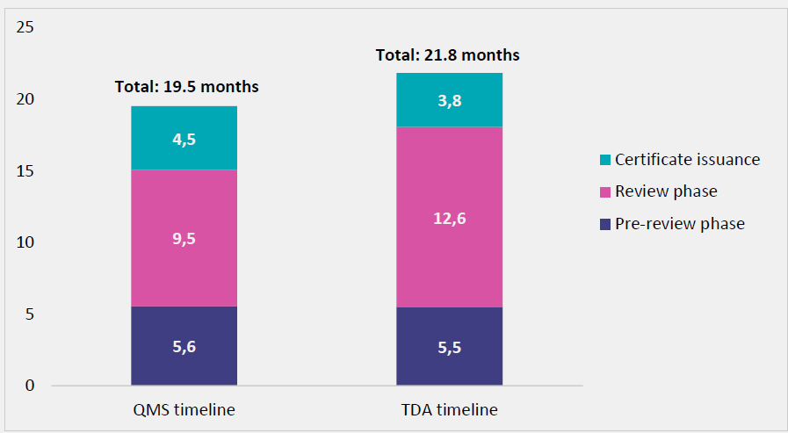
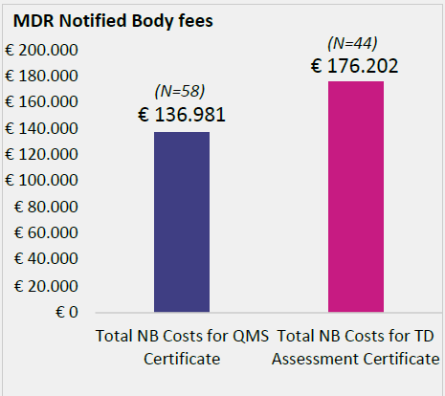

Summary and outlook-
Average certification times and cost under MDR have reached a problematic level.
Average MD certification time – QMS and TDA
The median review time is similar between large companies, with a significantly higher number of SMEs
experiencing >15 months for TDA
Timelines of TD assessment
disrupt product innovation.
Variables such as number of
devices covered by the QMS certificate should be considered. There is high variability in the certificate costs provided.
Especially cost for TD assessment have become barriers for SME’s.

Slide 28
Summary and outlook.
The judgment about MDR after years is mostly negative, on the side of industry and their lobby associations but also on the side of the healthcare system.
Four reasons for the problems resulting from MDR:
The basic assumption that EU medical devices were less safe and medtech companies less compliant was driven by political sentiment in the European parliament and not based on facts.
Overestimation of the adaptability of the system of Notified Bodies in terms of change management and capacity buildup has led to significant shortage in supply of regulatory services and has substantially driven up cost and timeline.
Unwillingness of the Commission to ensure a level playing field between industry and Notified Bodies with transparency and framework conditions to regulate the service rendering.
Inability of the Commission to comply with its own proceedings and making essential platforms available in time, such as the EUDAMED system.
Consequences for European stakeholders (industry, healthcare sector):
Weakening of international competitiveness of the European medtech industry, especially against US and Chinese competitors.
Reduced R&D slows down clinical progress and reduces the role of Europe in clinical science.
Margin pressures due to regulatory cost explosion can put smaller firms at riks. Cessations of businesses especially in traditional, family-owned SME sector or M&A driven by private equity firms.
Product price increases for hospitals and the healthcare sector (companies openly argue with MDR-related cost burden).

Slide 29
Summary and outlook.
The European Commission has launched a comprehensive evaluation of the MDR) and IVDR to assess the impact, effectiveness, and challenges of the new regulations.
1. Who is conducting the evaluation? The evaluation is coordinated by the European Commission itself, specifically by the Directorate-General for Health and Food Safety (DG SANTE). EY has been commissioned to conduct surveys, interviews, and analyses. The Commission involves various stakeholders, including industry representatives, notified bodies, medical societies, patient organizations, and authorities.
2. How long does the evaluation take? The evaluation started in 2023. The public consultation ran until the end of 2023. The analysis was mostly completed during 2024. The reporting date depends on the scope of the feedback and the complexity of the evaluation.
3. What are the expected results? The evaluation aims to address the following aspects:
Is the MDR working as intended (patient safety, market surveillance)?
Are there unintended negative effects (e.g., barriers to innovation, withdrawal of products, shortages)?
What is the burden on manufacturers, notified bodies, and other stakeholders?
Is there potential for improvement or need for amendments to the regulation?
The delay is mainly due to the complexity, the large number of stakeholders, and the need for careful evaluation. A specific publication date for the final report is not yet communicated.

Slide 30
Contact information
Prof. Dr. med. Marc Schurr
Ovesco Endoscopy AG
Friedrich-Miescher Str. 9
72076 Tuebingen
Germany
Tel: +49 (0)7071. 96528-121
marc.schurr@ovesco.com
www.ovesco.com

